Slide 1
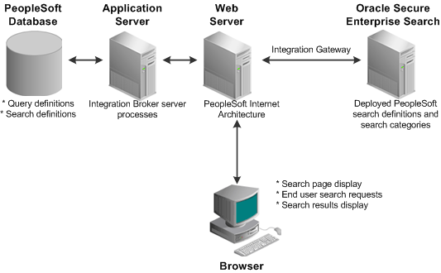
Arquitectura Peoplesoft

Slide 2
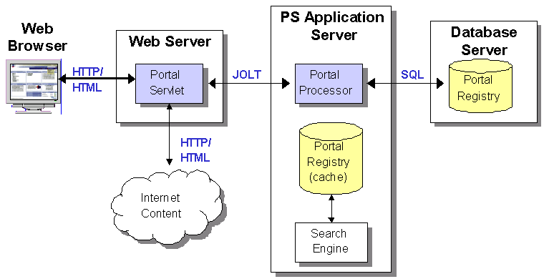
Arquitectura Peoplesoft

